Slide 1
Managing Projects with GitHub
DIV
Katie O’Connor
iyo6@cdc.gov
August 9, 2018
504
gcb

Slide 2

It is time to take the plunge and start using GitHub

Slide 3

Project management, made simple
On GitHub, project managers and developers coordinate, track, and update their work in one place, so projects stay transparent and on schedule.
Notes:
Why use GitHub?

Slide 4
ICPI GitHub Repositories (aka ‘repo’)
A repository is a substantive project. It hosts all (or most) of the code, data, and documentation used for a particular task or project.
A repo is a “master folder”, everything associated with a specific project should be kept in a repo for the project
Repos can have folders within them, or be just separate files
Notes:
1st step, create a repository. Lets review the list of repositories we have so far.

Slide 5
When should I create a repository?
Frequency
One time requests, eg subsetting a dataset. This should instead be stored in the related cluster's repo.
✅ Analysis that is ongoing or required quarterly/annually.
Usage
Analysis done for self or agency that doesn't serve the broader ICPI.
✅ Scripts or tools that help other analysis or field members perform their tasks more efficiency.
✅ Development around an ICPI tool or analysis.
Complexity
Code that is focused on relatively straight forward tasks such as simply subsetting a dataset.
✅ Multiple data sources and scripts requires to conduct analysis.
✅ R functions
Audience
Self
Trainings where the product is simply a presentation
✅ ICPI or field colleague

Slide 6
README file
You can add a README file to your repository to tell other people why your project is useful, what they can do with your proect, and how they can use it.
README file is often the first item a visitor will see when in your repo and should include:
What the project does
Why the project is useful
How users can get started with the project
Where users can get help with your project
Who maintains and contributes to the project
Notes:
Let us go to the DIV’s repo and look at their README file.

Slide 7
Issues – most useful features are:
Built-in tagging system
Milestones
Multi assignments
Commenting
Task lists
Markdown format
Project boards
Notes:
Some of GitHub Issues’ most useful features are:
Built-in tagging system: Allows you to organize and prioritize your workflow and to easily search through projects for relevant information.
Milestones: Perfect for associating issues with specific features or project phases, such as bugs that need to be fixed before a beta launch or tasks to be completed in October.
Multi assignments: Issues can be assigned to users in bulk, saving time and making you more efficient.
Commenting: Engineers and management teams can easily discuss progress and results at every step of the way using the inbuilt commenting system.
Task lists: Larger issues can be broken down into stages to discourage the creation of dozens of microscopic issues, keeping all of your work in the same place.
Markdown format: The ability to use markdown formatting will prove popular with your developers, and it can be used in most places around GitHub.
Project boards: These can be used to house issues, pull requests and notes, categorizing them as cards in columns of your choosing so you can look at larger projects as a whole.
High security: You can trust GitHub to keep your data safe, and it’s harder to breach than most other project management systems.

Slide 8
Start with an issue
Create an issue to suggest a new idea or track a bug.
Have a specific title – not too vague, not too detailed
Don’t spare any attachments—issues support most image and file types.
Then organize and assign tasks to your team.
Tag issues with labels
Notes:
Have participants open a repository like DAQ, view the Issues tab. Have them open a “New Issue” and talk about a creating a specific title. Review “leave a comment” box and then show them that you can attach a file. Go over assigning and labels.
NOTE-we will return to projects and milestones soon.

Slide 9
How can Issues be used for project management?
Having someone assigned or tagging issues with labels allows you to quickly search on the issues tab.
Filter your issues by who is assigned helps find all issues you are responsible for.
Filter your issues by label to find and reference all issues that are part of your project.
The Issues dashboard list the open issues you’ve created
You can update items that have gone stale
Close items
Keep track where you’ve been mentioned across all repositories – including those you’re not subscribed to
Notes:
Return to the Issues tab and sort by assignee or label.

Slide 10
Mentions, Assignees, and Notifications
Mentioning other people or teams in the issue will notify them if something changes.
Assign up to ten teammates to an issue or pull request to make sure work has an owner.
They can also stay in the loop by opting to receive notifications whenever someone posts a comment – in other words you are subscribing.
Notes:
Let’s try a new Repo like the DIV repo. Let’s go to Issue #88 called Q3 Pano Testing Schedule. Lets look at Jess’ comment and how at the end she not only mentions people but also has an attachment. See how after that, Katya assigns people to this issue. Now lets go to the notifications box and determine what we want to do.

Slide 11
Milestones and Checklists (aka task lists)
Add a milestone to track a project as part of a larger goal, like a quarterly to-do list or a big feature. Then watch your milestone’s overall progress.
Issue, comment, and pull request descriptions support checklists to coordinate and track parts of a project. Reorder tasks as your priorities change, and check them off as you complete each one.
Notes:
Still in the DIV’s repo, lets find issue #78. You can add a milestone to an issue which is one of the options on the right. Checklists can also be added when you are leaving a comment in an issue, you can select the “checkbox” feature in the ribbon.

Slide 12
See your work take shape with Projects
Projects help you organize and prioritize your work
Create customized workflows that suit your needs, for example:
To Do
Pending issues
Completed issues
Create notes within columns to serve as task reminders
Notes:
Now lets go to the HEI dashboard repo and go to the Projects dashboard.

Slide 13
Using GitHub for version control
Version control allows you to keep track of your work, helps you easily explore the changes you or others have made.
No longer need to do SOW_v1, SOW_v2, SOW_v100
Multiple versions are cumbersome to directly compare different versions
Not always easy to share among collaborators

Slide 14
Commit, Contributor, History, Change file
Commit – the changes you have made to the master file in your repo (editing the file)
Write a good commit message to identify the change you have made
Contributor – see who has made edits to the document
History shows you what was changed by who (see red for original, green for new edits)
Seeing what is different is referred to as a “change file”
* MD file? It's a plain text file that uses the Markdown language to describe how to convert a text document to HTML
Notes:
Alright, lets go to the DIVs <>code tab and look at their “Best practices, GitHub repos”.

Slide 15
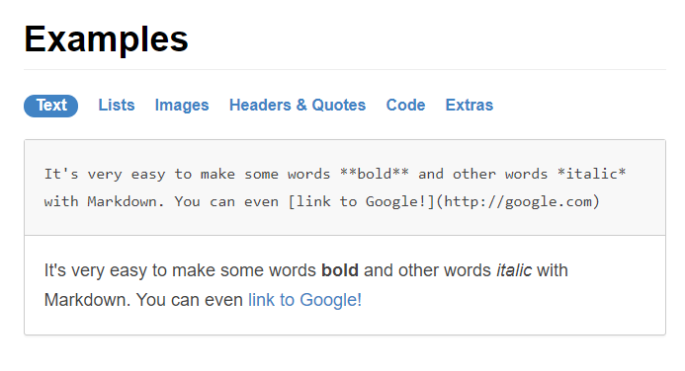
What is Markdown and why do I need to know this?
Markdown is an easy-to-read, east-to-write syntax for formatting plain text.
If a document is in markdown, GitHub will track all of the changes, who made them, and when.
Notes:
https://guides.github.com/features/mastering-markdown/#what

Slide 16
GitHub Wikis
Wiki is a place in your repo to share long-form content about your project, for example:
Meeting minutes
Resources
Membership names and roles
Scope of Work
Workplan
Different from a README file which is intended to quickly orient readers
Place to provide additional documentation

Slide 17
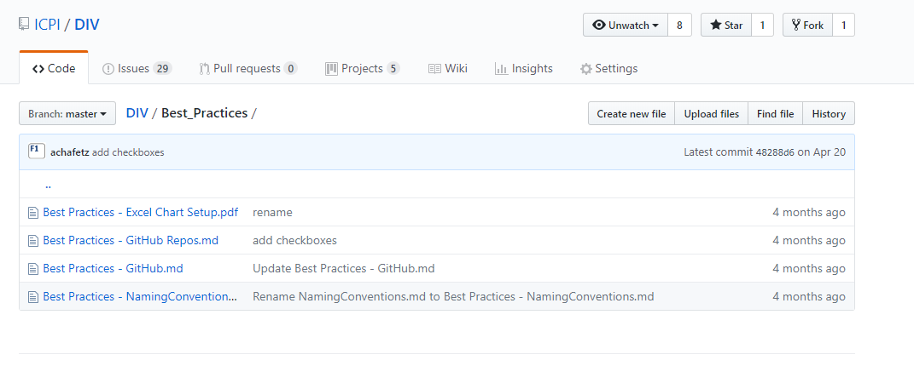
Resources

Slide 18



Questions & Discussion

